Slide 1
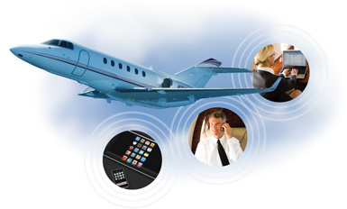
The Airborne Internet

Slide 2
Outline
What is the Airborne Internet.
How AI works.
Subscriber units.
Difference between Satellite and AI.
One Type of Airplanes.
Conclusion.

Slide 3
What is Airborne Internet
Some internet service:
1- cable TV
2- DSL
What is (AI)?
It is an internet broadband which Provide high-speed wireless internet connection by placing aircraft in fixed path over hundreds of cities

Slide 4
What is Airborne Internet
(AI) deliver high-speed internet :
Around 25Mb/s for business users
And around 5 Mb/s for home users
(AI) uses a network called High Altitude Long Operation (HALO)
This network is used by U.S. army.

Slide 5
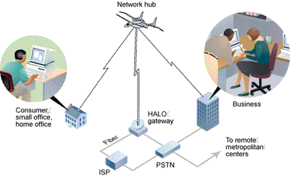
How AI Work
The aircraft work as hub
HALO work as wireless network with star topology
(ISP) Internet Service Provider send the data through a gateway to the hub in the aircraft

Slide 6
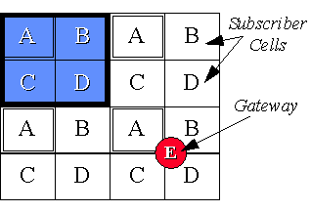
How AI Work
AI divide the area into different cells.
(mobile cells)
each spot beam serves a single "cell" on the ground in a frequency-division multiplex fashion with 5-to-1
four sub-bands for subscriber units
(A,B,C and D)
The fifth sub-band for the gateway
(E)

Slide 7
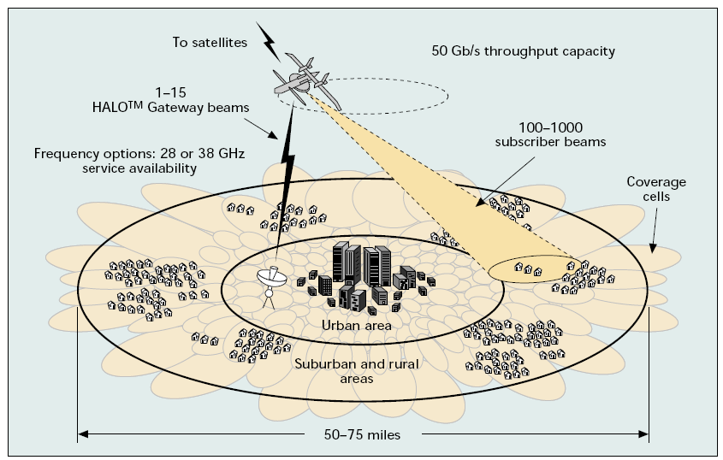
How AI Work
To provide the service for 24 hours, three aircraft will be used. Each one for 8 hours.

Slide 8
How AI Work
This service can cover cities
area around 75 mile in diameter
The aircraft will fly at altitude 51,000 ft
(15,500 m)
It use high-frequency.
between 28-38 GHz

Slide 9
Subscriber units
The user terminal consists of three main parts:
1- The radio frequency unit (RU)
a) MMW Antenna
b) MMW Transceiver
c) An antenna tracking unit
An antenna tracking unit uses a pilot tone transmitted from the HALO aircraft to point its antenna at the airplane
2- The Network Interface Unit (NIU)
3- the application terminals such as PCs, telephones, video servers, etc.

Slide 10
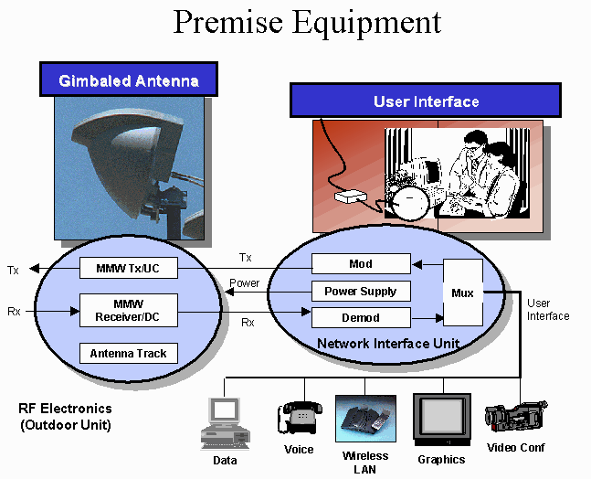
Subscriber units

Slide 11
Difference between Satellite and AI
AI does not need frequency bands license
Can service hundred-thousand of broadband subscribers
Single link delays range from ~60 msec under the airplane to ~200 msec at the edge of the signal

Slide 12
Difference between Satellite and AI
 | AI service | Satellite
Time delay | Small delay | Big delay
Frequency | 28-38 GHz | 4-6 GHz 9-13 GHz
Power | Low Power | High Power
Cost | Low Cost | High Cost

Slide 13
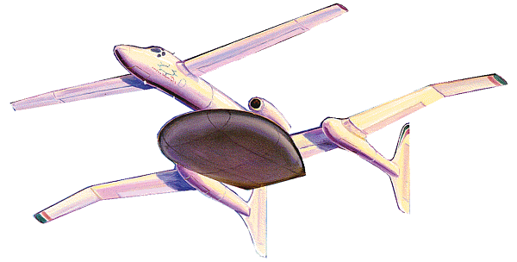
the Proteus airplane
The Proteus was developed by NASA
It is designed with long wings and low wing loading
It can fly in high-altitude
18-foot dish underneath the plane is responsible for reflecting high-speed data signals from a ground station to users.

Slide 14
Conclusion
The airborne internet provide high-speed internet.
AI has many advantage than satellite communication.
This new service will be useful for who live in small village

Slide 15
Source
http://www.isoc.org/inet99/proceedings/4d/4d_3.htm#s15
http://computer.howstuffworks.com/airborne-internet.htm
IEEE Communications Magazine • June 2000
page 142-148
MWCON'98 Proceedings page 9-14

Slide 16
Question
1- What is (AI) ?
It is an internet broadband by aircraft.
2- the aircraft works as
A- hub B- server C- ISP
3- which type of topology (HALO) use:
A- mesh topology B- star topology C- Ring topology
4- the frequency of (AI) is:
A- 20-30 MHz B- 28-38 KHz C- 28-38 GHz
5- the device which is used the pilot tone to direct the antenna is:
A- MMW Antenna B- MMW transceiver C- An antenna tracking unit

